Slide 1
Employee Data Analysis using Excel
STUDENT NAME : MONEESHA K
REGISTER NO : 312210020
NAAN MUDHALVAN ID NUMBER :
D3FA39379B339C8BCD54B7B3B408E0F4
DEPARTMENT : B.Com (General)
COLLEGE : VALLIAMMAL COLLEGE FOR WOMEN

Slide 2
PROJECT TITLE
Employee Performance Analysis using Excel

Slide 3


AGENDA
Problem Statement
Project Overview
End Users
Our Solution and Proposition
Dataset Description
Modelling Approach
Results and Discussion
Conclusion
3/21/2024 Annual Review

Slide 4

PROBLEM STATEMENT
Assessing performance helps to identify strength , weakness , and areas for improvement.
Helps in valuation of incentives , promotions and bonuses to employees.
Performance of data structure gives ideas for organizational planning and resource allocation.
It improves personal growth by encouraging employees self – improvement and skill development.

Slide 5

PROJECT OVERVIEW
Employees performance analysis is a systematic process of evaluating an employees work performance, productivity and contributions to the organization. It involves assessing various aspects of an employees such as gender, performance level , achievements and current employees ratings.
It help in visualizing categories of employees based on their performance like high , medium , low . This is mainly done to make better decisions and better alignment with organizational goals.
Regular employee performance analysis support the organization by optimizing the employees talent , drive business success and foster a culture of continuous improvement in organization.

Slide 6
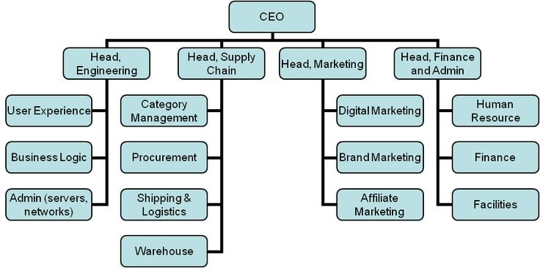

WHO ARE THE END USERS?

Slide 7

OUR SOLUTION AND ITS VALUE PROPOSITION
Conditional formatting - finding of missing values
Filter - for removing values
Formula - analyzing performance of employees
Pivot table - summarization of data
Graph - data visualization
Pie chart – data visualization

Slide 8
Dataset Description
Employee Data - kaggle
26 : features
09 : features selected
Employee ID - number
Name - text
Business unit
Employee status
Employee type
Gender - male , female
Performance core
Employee ratings - numerical values
Performance level

Slide 9

THE "WOW" IN OUR SOLUTION
Performance level =IF(Z2>=5,"VERY HIGH",IF Z2>=4,"HIGH",IF Z2>=3,"MED",IFZ2>=2,"LOW")
3/21/2024 Annual Review
9

Slide 10
MODELLING
Data collection :
Data is collected from kaggle application for the analysis.
The data is taken based on the concept of employees.
Here the analysis explains about the employees performance in the company.
It is stated as Employee Performance Analysis.
Features of collection :
Data set of employees contains 26 features and from this 9 features are selected for analyses.
Main features are taken such as employee ID, name, business unit, employee status, employee type, gender, performance core, employee ratings and performance level.
Data cleaning :
Some columns contain blank values data they are first identified by using conditional formatting and they are seperately segregated by highlighting the missing columns with the colors.
So the missing valuing are identified and sorted by conditional formatting.
10

Slide 11
MODELLING
Performance level :
Data of employees ratings which are represented in numerical values are categorized based
on their performance such as low, mid, high and very high.
Categories of ratings are done by verifying the multiple conditions which uses IFS formula.
IFS formula used for checking the true value.
Example - Performance level =IFS(Z2>=5,“VERY HIGH”,Z2>=3,“MED”,TRUE,“LOW”)
After applying formula they are applied to all other rows .
Summary :
The summarization of huge data is columns and rows is called pivot table.
Pivot table can be selected in insert option . They can be segregated as per the rows and
columns by dropping in respective columns.
Pivot table also contains a new feature known as slicer which helps is the collecting of
specified data.
Example – part time employees

Slide 12
MODELLING
Visualization :
The data which are summarized in table format of pivot chart are represented as
graphical representation.
Graph was created by using the option chart by our own idea or recommendation chart
provided.
Pie chart can also be created for better visualization.

Slide 13
RESULTS
13

Slide 14
conclusion
Comparison :
Low performing employees are more in the organization as per the graph.
Measures can be taken to identify their issues in particular field and giving them training,
develop a structured improvement plan, offer rewards for employees who achieved their
targets, encourage team work and collaboration, develop new skills and interest for
employees.
Trend Line Analysis :
Trend line represents in graph is represent the range of low performing employees.
It shows a linear decreasing line of various company employees.
Lower performance Employees Higher - MSC
Lower performance Employees lower - BPC , WBL

